Slide 1
Computer Graphics The GPU and WebGL
László Szécsi szecsi@iit.bme.hu
AIT

Slide 2

“
This is the story of the Going Home.
This is the story of the Critical Path.
This is the story of the truck roaring through the sleeping city and out into the country lanes, smashing through streetlamps and swinging from side to side and shattering shop windows and rolling to a halt when the police chased it. And when the baffled men went back to their car to report Listen, will you, listen? There isn't anyone driving it!, it became the story of the truck that started up again, rolled away from the astonished men, and vanished into the night.
”

Slide 3
Comparison
Nomes
GPU cores
pretty small (6’’)
strength: numbers
there are thousands!!!
weakness: quarrelling
working at odds
need common leadership
pretty small
strength: numbers
thousands on a card
also good at math
weakness: all must do the same thing (or be idle)
need common leadership

Slide 4
GPU pipeline input
vertex buffers
index buffer
render state
operation settings of fixed-function pipeline stages
shader programs for programmable stages
resources – data in global device memory
global (uniform) variables
textures
data buffers
read only
Notes:
For the GPU to work, we must provide inputs. These have to describe all the geometry (the models [shapes] of the objects) of the virtual world, plus other aspects of the virtual world (studio objects like lights and cameras, or the locations and orientations of the aforementioned objects).
We also need to set all render states (but they have nice defaults), and upload any other media necessary (like texture images).

Slide 5
GPU pipeline output
frame buffer - default frame buffer is the screen
color attachments / color buffers - there is a default
depth buffer (+stencil) - there is a default
Notes:
The output is an image. In OpenGL, they call the output the frame buffer --- as it is one frame in the digital film constituted by the images rendered one after the other.
A frame buffer may contain multiple color buffers --- called color attachments, as they are attached to the frame buffer. By default, there is one color buffer, associated with the display device. Multiple color buffers are only used in advanced techniques like deferred shading --- not a core subject in this course.
The frame buffer can also have a depth buffer attached, which will be useful for 3D graphics, solving the occlusion (or visibility) problem.

Slide 6
GPU pipeline
IA
VS
IA
RS
FS
OM
+all units can access uniform variables,
textures, and buffers
Notes:
Here is a minimal representation of the pipeline – sufficient for our purposes.
The input assembler (IA) gathers the data from the vertex buffers that describe one vertex.
These are inputs to the vertex shader (VS), which performs some computations and outputs a processed vertex record.
The input assembler (second incarnation) queries the index buffer to assemble primitives from the vertices.
The rasterizer (RS) breaks down the primitives to fragments.
The fragment shader (FS) finds them colors.
The output merger (OM) wrties the colors into the pixels of the color buffer, or discards them, or combines the two.

Slide 7
Render state
IA
IA
RS
OM
input
layout
primitive
topology
rasterizer
state
viewport
depth-stencil
state
blend
state
Notes:
We need to set up the fixed function elements of the pipeline by setting render states.
The IA needs to know about the content of the vertex buffers: what attributes are there and where, i.e. the attribute layout.
The primitive topology (point, line, triangle) also have to be selected.
The rasterizer has a large number of render states (the default is OK for most of them, most of the time).
The output merger can be set up to perform blending (for transparency) or depth testing (for 3D).

Slide 8
Vertex assembly
Vertex buffers
arrays of records
record fields are called vertex attributes
pos
normal
pos
normal
pos
normal
pos
normal
vertex
tex
tex
tex
tex
IA
vertex
Notes:
Vertices contain positions, with possibly other attributes attached to them. The vertex buffer contains an array of records describing these attributes. Multiple vertex buffers can also be used, e.g. one for each attribute.

Slide 9
Vertex shader
input data
uniform: camera, lights, material properties, etc.
by vertex: vertex attributes [position, normal, color, texcoord]
output data
position in screen coordinates
vertex color
anything else [e.g. texcoord]
VS
Notes:
The vertex shader takes the model vertex from the vertex buffer(s) as an input. It must compute where the vertex should appear on the screen. This is not the same position as the position of the vertex in the vertex buffer, as the same geometry can be drawn multiple times, as different locations.
The vertex shader can get uniform inputs, that is, inputs not from the vertex buffer. These are the same for all vertices. E.g. the location of the currently drawn object (mentioned above) would be a uniform parameter.
Vertex shader outputs may include various other values, at the programmer’s discretion. For example, the VS can compute the apparent color of a vertex under given lighting conditions. These VS outputs as also called ‘varying’ variables in OpenGL.

Slide 10
Primitive assembly
Index buffer
array of integers
Indexed primitive
vertices that belong to a triplet of indices in index buffer
IA
Notes:
The index buffer contains a list of numbers indexing vertices. A group of indices specifies a primitive.

Slide 11



Primitive topology (essential examples)
GL_POINTS
GL_LINES
GL_TRIANGLES
Notes:
The are many possible primitive topologies --- ways of assembling primitives from the vertex and index data. Most important for us is the ‘triangles’ topology, where non-overlapping triples from the index buffer give the three vertices of triangles. This representation is ideal for triangle mesh models used in games.

Slide 12
Rasterizer: back-face culling
throw away triangles based on winding (vertices appear clockwise or counter-clockwise)
if our model (as specified by the index buffer) has consistent winding, we can cull back-faces
inside faces are never seen for a polyhedron
Notes:
The rasterizer gets the primitives. It may throw some triangles out based on their winding (clockwise or counter-clockwise). This is useful if we have a closed polyhedron model. If, in the model’s index buffer, the triangles vertices are specified in such an order, that they are listed clockwise, when looking at the triangle from the outside, then front-facing triangles will have CW winding on-screen, and back-facing ones will have CCW. As backfaces of a closed polyhedron are never visible from the outside, these do not have to be drawn.

Slide 13
Rasterizer: clipping
clip away parts not on screen
also clip away parts too near or too far
this will be needed for 3D occlusions (z-buffering works for finite range)
clip to screen space box
[-1, -1, -1] [1, 1, 1]
Notes:
The rasterizer also gets rid of parts of primitives extending beyond the screen (or too near or too far, for 3D graphics). This is called clipping.

Slide 14
Rasterization
viewport transformation: get pixel coordinates
linear interpolation
interpolate all vertex output data (except for position) for every output fragment
launch a fragment shader for every fragment with interpolated data as parameters
RS
Notes:
For primitives not thrown away, the viewport coordinates (pixel row, pixel column) are computed, and the pixels to be filled are identified – and called fragments, as they are not quite written to the color buffer yet. The VS outputs (a.k.a. varyings) are interpolated linearly over all the fragments, and a fragment shader if invoked to find the color of each.

Slide 15
Fragment shader
input data
vertex shader outputs, interpolated
pixel coordinates
output data
pixel color [RGBA]
PS
Notes:
The fragment shader gets the interpolated vertex output (varyings), and must compute the fragment color.

Slide 16
Output merger
target: frame buffer
blending
mix fragment color with target pixel color
can use alpha from fragment shader for weighting
OM
Notes:
The output merger writes the fragment color into the appropriate pixel of the color buffer – or combines it with the color already there, in some way.

Slide 17
In App constructor: create gl context
.
class App{
constructor(canvas, overlay) {
this.canvas = canvas;
this.overlay = overlay;
this.gl = canvas.getContext("webgl2");
if (this.gl === null) {
throw new Error("Browser does not support WebGL2");
}

Slide 18
In App constructor: create Scene instance
.
this.gl.pendingResources = {};
this.scene = new Scene(this.gl);
this.resize();
}
this property injected into the OpenGL context object
will be useful for monitoring loading images and 3D models,
when we get there
object literal for empty object
this will be our object responsible for creating and drawing the virtual world

Slide 19
In App’s resize
.
resize() {
this.canvas.width = this.canvas.clientWidth;
this.canvas.height = this.canvas.clientHeight;
this.scene.resize(this.gl, this.canvas);
};
let the scene set up drawing for the current resolution and aspect ratio

Slide 20
In App’s update
.
update() {
const pendingResourceNames = Object.keys(this.gl.pendingResources);
if (pendingResourceNames.length === 0) {
this.scene.update(this.gl, this.keysPressed);
this.overlay.innerHTML = "Ready.";
} else {
this.overlay.innerHTML =
`<font color="red">Loading: ${pendingResourceNames}</font>`;
}
window.requestAnimationFrame( () => this.update() );
};

Slide 21
How to draw a triangle?
create and fill with data (in Scene constructor)
vertex buffer
input layout (explain vertex buffer contents)
index buffer
vertex shader + fragment shader = program
when drawing (in Scene's method update)
set buffers, layout
set program
launch pipeline to draw
class TriangleGeometry
class Shader
class Program

Slide 22
Additional .js files in index.html

we need:
Scene.js – representation, animation, and rendering of the virtual world
TriangleGeometry.js – creation of vertex, index buffer, and input layouts
Shader.js – loading and compilation of GLSL shader sources
Program.js – management of shader setups and their inputs
files are in the js folder, next to App.js
files included in index.html using script tags

Slide 23
WebGL functions
the following slides show code in the downloaded project
WebGL is not object oriented
some resource must be bound
then operations affect it
these lines of code go together
you use WebGL snippets of code, not individual function calls

Slide 24
TriangleGeometry – class definition

"use strict";
/* exported TriangleGeometry */
class TriangleGeometry {
constructor(gl) {
this.gl = gl;
enable helpful JS error checking
suppress unused variable warning from JSHint
store WebGL context for later use

Slide 25
TriangleGeometry - create a vertex buffer

OpenGL dictionary
array buffer: vertex buffer
this.vertexBuffer = gl.createBuffer();
gl.bindBuffer(gl.ARRAY_BUFFER, this.vertexBuffer);
gl.bufferData(gl.ARRAY_BUFFER,
new Float32Array([
-0.5, -0.5, 0.5,
-0.5, 0.5, 0.5,
0.5, 0.0, 0.5,
]),
gl.STATIC_DRAW);
OpenGL phraseology
Binding means: select as current. Further operations on the same
target affect the bound resource.
A regular JS array of numbers used to create a typed array. We must upload floats to the GPU.
vertex position data
x, y, and z coordinates for 3 vertices

Slide 26
TriangleGeometry - create an index buffer

OpenGL dictionary
element array buffer: index buffer
this.indexBuffer = gl.createBuffer();
gl.bindBuffer(gl.ELEMENT_ARRAY_BUFFER, this.indexBuffer);
gl.bufferData(gl.ELEMENT_ARRAY_BUFFER,
new Uint16Array( [0, 1, 2, ] ),
gl.STATIC_DRAW);

Slide 27
TriangleGeometry – create input layout

this.inputLayout = gl.createVertexArray();
gl.bindVertexArray(this.inputLayout);
gl.bindBuffer(gl.ARRAY_BUFFER, this.vertexBuffer);
gl.enableVertexAttribArray(0);
gl.vertexAttribPointer(0,
3, gl.FLOAT, //< three pieces of float
false, //< do not normalize (make unit length)
0, //< tightly packed
0 //< data starts at array start
);
gl.bindVertexArray(null);
} // constructor ends
OpenGL dictionary
vertex array object (VAO):
input layout
this explains how attribute 0 can be found in the vertex buffer

Slide 28
Shader source code management

// in Shader.js
Shader.source = {};
// in js/shaders/*.glsl
Shader.source[document.currentScript.src.split('js/shaders/')[1]] = `#version 300 es
in vec4 vertexPosition;
void main(void) {
gl_Position = vertexPosition;
}
`;
A collection of shader source code strings.
A property of the Shader constructor,
not the prototype
i.e. there will be only one object, not one per constructor invocation
JS code that adds a property to Shader.source.
The property name is the file name, the value is the GLSL code string.
version info must be on first line
actual GLSL shader code

Slide 29
Creating a shader (without the error logging magic)

class Shader {
constructor(gl, shaderType, sourceFileName) {
this.glShader = gl.createShader(shaderType);
gl.shaderSource(this.glShader, Shader.source[sourceFileName]);
gl.compileShader(this.glShader);
if (!gl.getShaderParameter(this.glShader, gl.COMPILE_STATUS)){
gl.getShaderInfoLog(this.glShader);
}
};
vertex shader or pixel shader
get an OpenGL shader ID
associate source code with ID
compile GLSL code to binary
check if succeeded and get compilation error message

Slide 30
Vertex shader
A four-element vector [x,y,z,w].
We leave z and w alone.
They will be useful later for 3D graphics and transformations.

attribute fetched from vertex buffer according to input layout spec
#version 300 es
in vec4 vertexPosition;
void main(void) {
gl_Position = vertexPosition;
}
built-in output, required

Slide 31
Fragment shader
A four-element vector [r,g,b,a].
Alpha is opacity, we set it to 1 for opaque.
It will be useful later for transparency.

#version 300 es
precision highp float;
out vec4 fragmentColor;
void main(void) {
fragmentColor = vec4(1.0, 1.0, 0.0, 1.0);
}
arbitrarily named output
solid yellow

Slide 32
Linking shaders into program
class Program {
constructor(gl, vertexShader, fragmentShader) {
this.glProgram = gl.createProgram();
gl.attachShader(this.glProgram, vertexShader.glShader);
gl.attachShader(this.glProgram, fragmentShader.glShader);
gl.bindAttribLocation(this.glProgram, 0, 'vertexPosition');
gl.linkProgram(this.glProgram);
// plus error handling
};
OpenGL phraseology
you attach resources to one another
vertex shader input variable
is taken from vertex buffer's attribute 0

Slide 33
Summary of attribute specs chain
input variable is declared in VS
we bind it to an attribute #0 in Program.js
in TriangleGeometry.js
we create and fill buffer
and explain layout
in vec4 vertexPosition;
gl.bindAttribLocation(this.glProgram, 0, 'vertexPosition');
this.vertexBuffer = gl.createBuffer();
gl.bindBuffer(gl.ARRAY_BUFFER, this.vertexBuffer);
gl.bufferData(gl.ARRAY_BUFFER,
new Float32Array( [
-0.5, -0.5, 0.5,
-0.5, 0.5, 0.5,
0.5, 0.0, 0.5, ] ),
gl.STATIC_DRAW);
gl.bindBuffer(gl.ARRAY_BUFFER, this.vertexBuffer);
gl.enableVertexAttribArray(0);
gl.vertexAttribPointer(0,
3, gl.FLOAT,
false, 0, 0
);

Slide 34
Input defaults
if the attribute data has less elements than the VS input variable, missing values default to
x=0, y=0, z=0, w=1
input variable is declared in VS
we bind it to an attribute #0 in Program.js
in TriangleGeometry.js
we create and fill buffer
and explain layout
in vec4 vertexPosition;
gl.bindAttribLocation(this.glProgram, 0, 'vertexPosition');
this.vertexBuffer = gl.createBuffer();
gl.bindBuffer(gl.ARRAY_BUFFER, this.vertexBuffer);
gl.bufferData(gl.ARRAY_BUFFER,
new Float32Array( [
-0.5, -0.5, 0.5,
-0.5, 0.5, 0.5,
0.5, 0.0, 0.5, ] ),
gl.STATIC_DRAW);
gl.bindBuffer(gl.ARRAY_BUFFER, this.vertexBuffer);
gl.enableVertexAttribArray(0);
gl.vertexAttribPointer(0,
3, gl.FLOAT,
false, 0, 0
);

Slide 35
Scene constructor – resource creation

this.vsIdle = new Shader(gl, gl.VERTEX_SHADER, "idle-vs.glsl");
this.fsSolid = new Shader(gl, gl.FRAGMENT_SHADER, "solid-fs.glsl");
this.solidProgram = new Program(gl, this.vsIdle, this.fsSolid);
this.triangleGeometry = new TriangleGeometry(gl);

Slide 36
Scene update - drawing

gl.clearColor(0.6, 0.0, 0.3, 1.0);
gl.clearDepth(1.0);
gl.clear(gl.COLOR_BUFFER_BIT |
gl.DEPTH_BUFFER_BIT);
this.solidProgram.glProgram.use();
this.triangleGeometry.draw();

Slide 37
TriangleGeometry draw

gl.bindVertexArray(this.inputLayout);
gl.bindBuffer(gl.ELEMENT_ARRAY_BUFFER, this.indexBuffer);
gl.drawElements(gl.TRIANGLES, 3, gl.UNSIGNED_SHORT, 0);
DRAW CALL!!!
pipeline now fully set up, commence processing

Slide 38
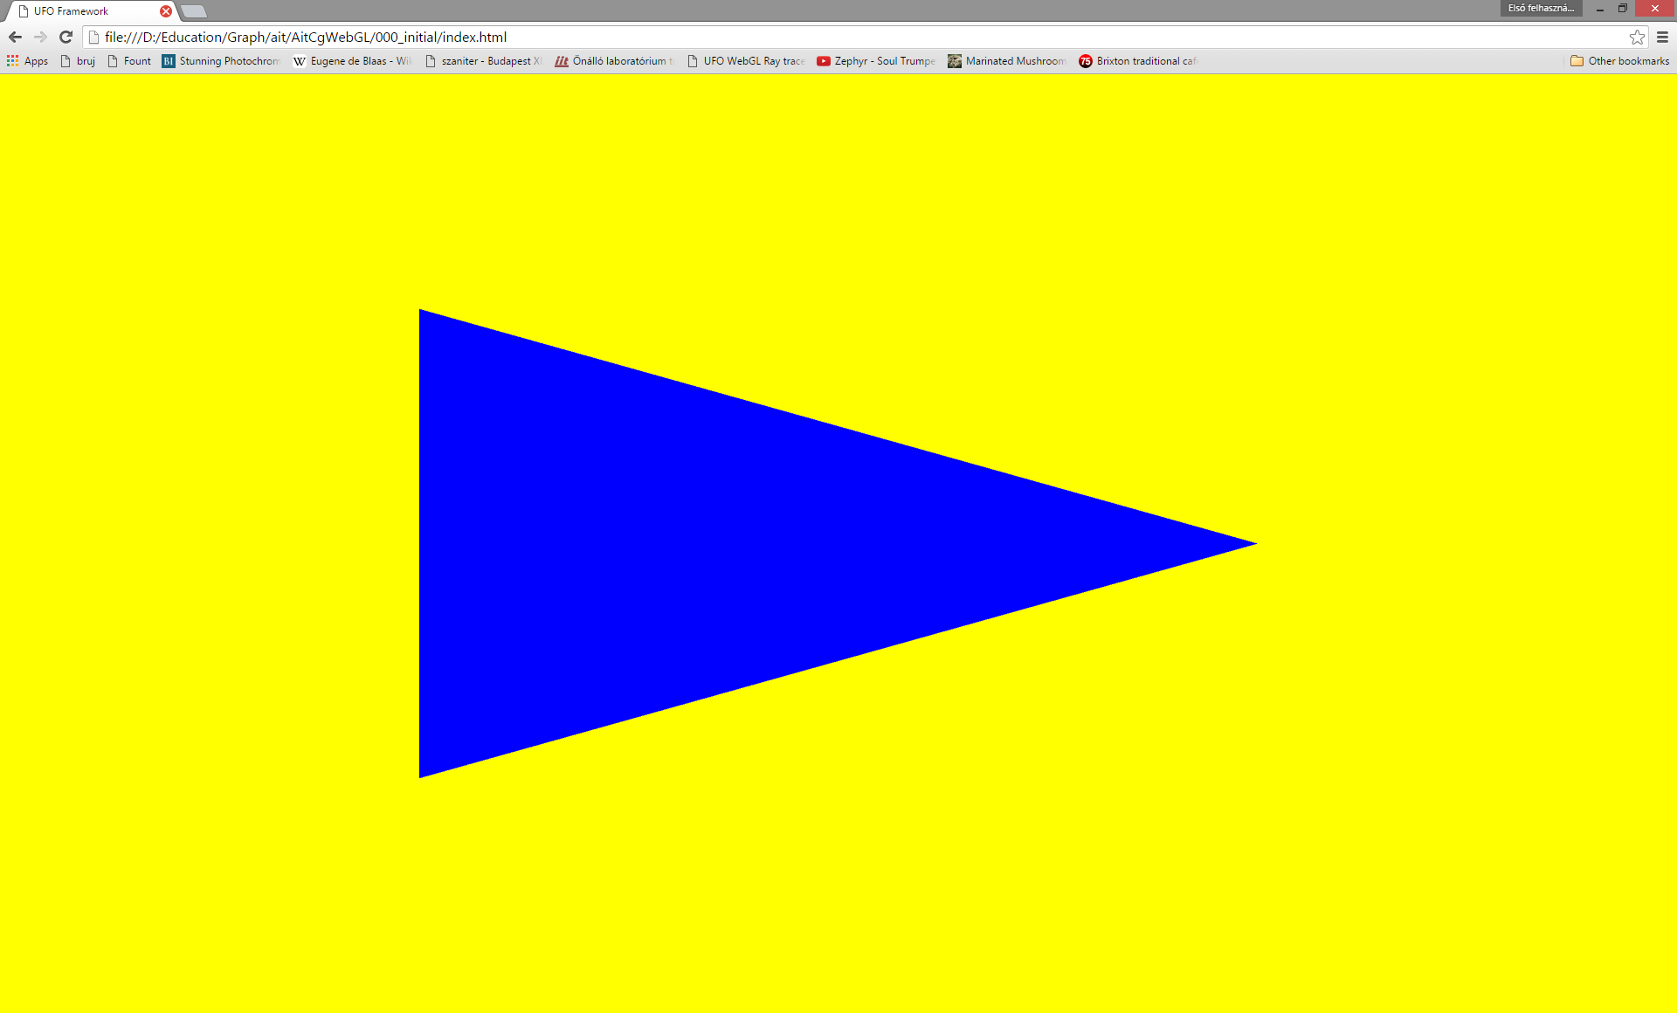
Initial code

Slide 39
Figure out how to
!
change background color
change vertex positions
change triangle color

Slide 40
Add new vertex attribute: vertexColor
!
new vertex buffer for color data (TriangleGeometry.js)
three floats per vertex (Red, Green, Blue)
binding, enabling, and layout spec (as attrib #1) for new vertex buffer (TriangleGeometry.js)
new input attribute in vertex shader [idle-vs.glsl]
binding input variable as attribute #1 (Program.js, before linking shaders)
this does not show yet, as the attribute is not used in the shaders (see following slide)
in vec4 vertexColor; // attribute from VB

Slide 41
New VS out/FS in: color
!
add out to vertex shader
in to fragment shader
output the value of vertexColor as color in vertex shader (a simple assignment)
output the value of color as fragmentColor in fragment shader (another assignment)
out vec4 color; // passed to FS
in vec4 color; // received from VS via RS

Slide 42
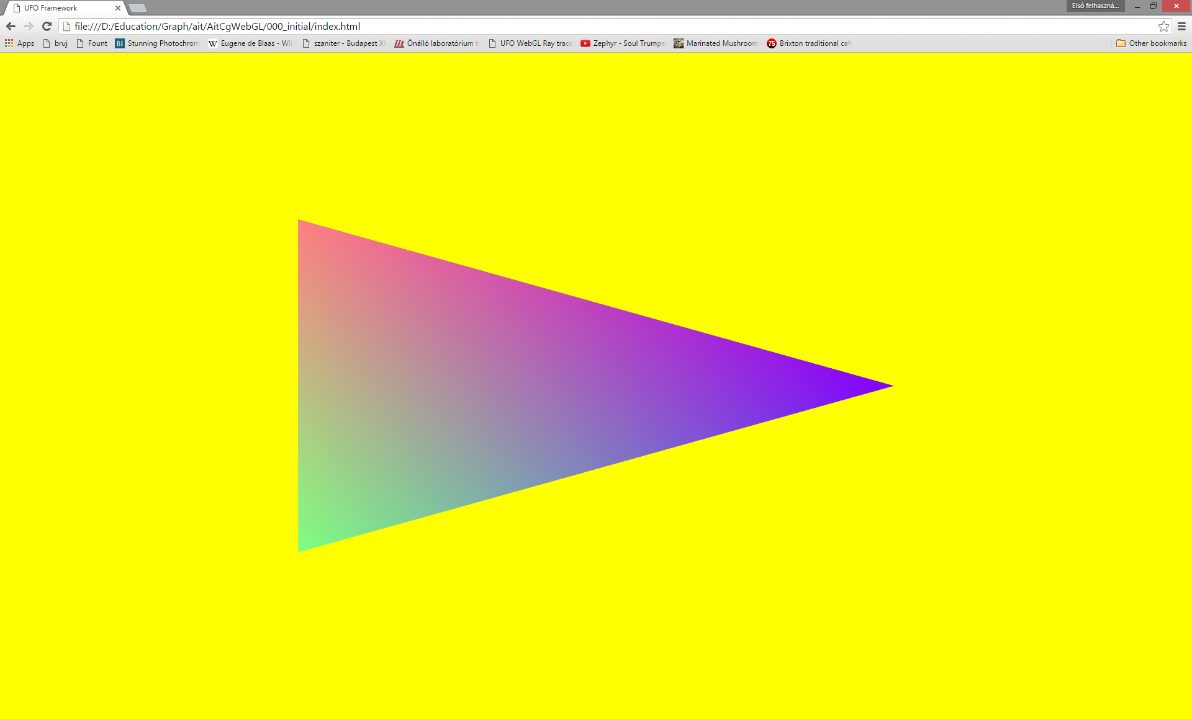
Garish triangle

Slide 43
Create QuadGeometry
!
duplicate and rename the copy of TriangleGeometry.js
include into index.html with the script tag
change class name
change vertex buffer contents to specify 4 vertices
change index buffer contents to specify 2 triangles
change draw call invocation to process 6 indices
create an instance of QuadGeometry in the Scene constructor
draw it in update

